Slide 1
Finding Similar Items in Large Datasets
Zhe Zhou, Qianyan Wu, Zhihao He, Brandon D’Anna

Slide 2
Introduction/Motivation
Fundamental data mining problem
Examples include identifying plagiarism, grouping news article from the same source, entity resolution
Naive approach would require the comparison of each pair of items. The number of pairs can increase drastically as the total number of items increase
In a world where billion row datasets are common, naive approach is not feasible
Family of techniques known as locality-sensitive hashing (LSH) focus on pairs likely to be similar
Avoids quadratic growth in computation time
Introduces false negatives, fraction can be reduced with tuning

Slide 3
Key Ideas
Items
Shingling
Locality-Sensitive Hashing
Jaccard Similarity
MinHashing

Slide 4
Jaccard Similarity
Metric used to calculate how similar two sets are
Given sets X and Y, the Jaccard Similarity and Distance respectively are:
sim(X,Y) = |X ∩ Y|/|X ∪ Y| d(X,Y) = 1 - sim(X,Y)
|X ∩ Y| = 5
|X ∪ Y| = 15
sim(X,Y) = 1/3

Slide 5
Shingling
Shingling is the process of converting documents into sets
A k-shingle is a sequence of k characters that appear in the document
Example:
Document = “This is AMS 598”, k = 2
Set = {Th, hi, is, s_, _i, _A, AM, MS, S_, _5, 59, 98}
“_” denote a space in a string
Notice elements “is” and “s_” only appear once as sets do no contain duplicates

Slide 6
Sets as a Boolean Matrix
We can determine the similarities between sets by creating a matrix in which:
Rows are the universal set of elements
Columns each represent a set
Column A
Column B
a
1 | 1
0 | 1
0 | 1
0 | 0
b
c
d

Slide 7
Revisiting Jaccard Similarity
We can alternatively define Jaccard Similarity as sim(col A, col B) = a / (a + b + c)
Rows of type a indicate the element is a member of both sets
Rows of type b or c indicate the element is only a member of one set
Rows of type d indicate the element is a member of neither
Column A
Column B
a
1 | 1
1 | 0
0 | 1
0 | 0
b
c
d
Notes:
D is typical of a sparse matrix

Slide 8
MinHashing
Signatures take up much less space than sets, allowing for work to be done in main memory instead of with disk
Steps:
Permute the rows randomly
Define a minhash function h(column) = number of the first row in which the column has a 1 in permuted order
Repeat the permutation and minhash function creation upwards of 100 times
These create a signature which in turn can be used to create its own matrix

Slide 9
Signature Matrix
Permutation
Col A
Col B
Col C
3
5
3
1 | 0 | 1
1 | 0 | 0
0 | 1 | 0
0 | 1 | 0
1 | 0 | 0
3 | 1 | 3
1 | 3 | 5
1
2
5
1 | 2 | 3
2
3
1
5
4
2
A-C
A-B
B-C
Full matrix
1/3 | 0 | 0
1/3 | 0 | 0
4
1
4
Sig matrix
Notes:
Surprising property, sim(A,B) = probability h(A) = h(B), already know a / (a + b + c) for jaccard. For minhash, it’s probability first row that’s not a d type is an a type which would be a / (a + b + c)

Slide 10
MinHashing Feasibility
Issue:
Permutations become infeasible as the number of rows increase
1 billion row permutation takes ~ 4 GB of memory, 100 permutations take ~ 0.5 TB
Solution:
Pick around 100 hash functions
Create a placeholder for each hash function, i and column, C i.e. sig(C)[i]
Initialize each sig(C)[i] to infinity
Loop through each cell in the matrix.
For each 1 found, replace current with value of hash function if k(i) < sig(C)[i]

Slide 11
Locality-Sensitive Hashing (LSH)
Focus on pairs of signatures likely to be from similar documents
Basic Idea:
two points that are very close (similar) in the original space, after being mapped by the LSH hash function, have a high probability that their hashes are the same;
Similarly, two points that are not close(not similar), after mapping, the probability that their hash values are equal is very small.
Use a function f(x,y) that tells whether x and y is a candidate pair: a pair of elements whose similarity must be evaluated

Slide 12
Locality-Sensitive Hashing (LSH)
Focus on pairs of signatures likely to be from similar documents
Previous Output: A signature matrix
Next goal: control the relationship between the similarity and the mapping probability
Step 1:
Divide the signature matrix horizontally into some blocks (denoted as bands)
each band contains the r rows in the signature matrix
each band of the same column belongs to the same document
similar columns are likely to hash to the same bucket, with high probability
We call those that hash to the same bucket Candidate pairs

Slide 13
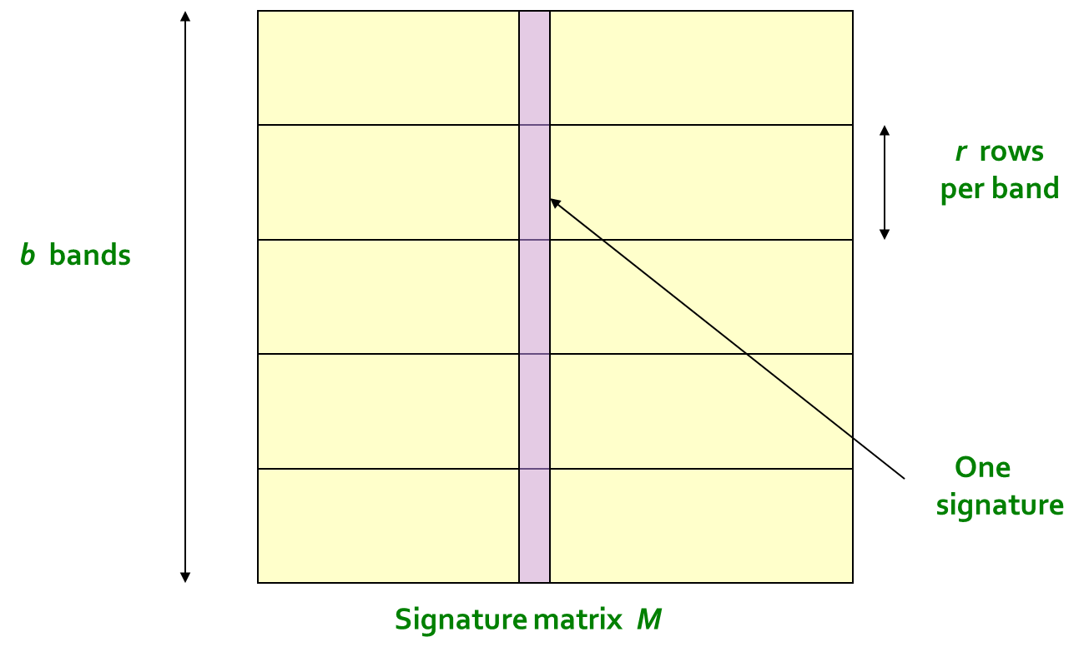
Locality-Sensitive Hashing (LSH)
Focus on pairs of signatures likely to be from similar documents

Slide 14
Locality-Sensitive Hashing (LSH)
Focus on pairs of signatures likely to be from similar documents
Step 2:
Calculate the hash value for each band. The hash algorithm here has no special requirements, MD5, SHA1, etc. can be used.
In general, we need to process these hash values to make them the tags of the pre-set hash bucket, and then "throw" these bands into the hash bucket.
Candidate column pairs are those that hash to the same bucket for ≥ 1 band
For each band, hash its portion of each column to a hash table with k buckets
Tune b and r to catch most similar pairs, but few non-similar pairs

Slide 15
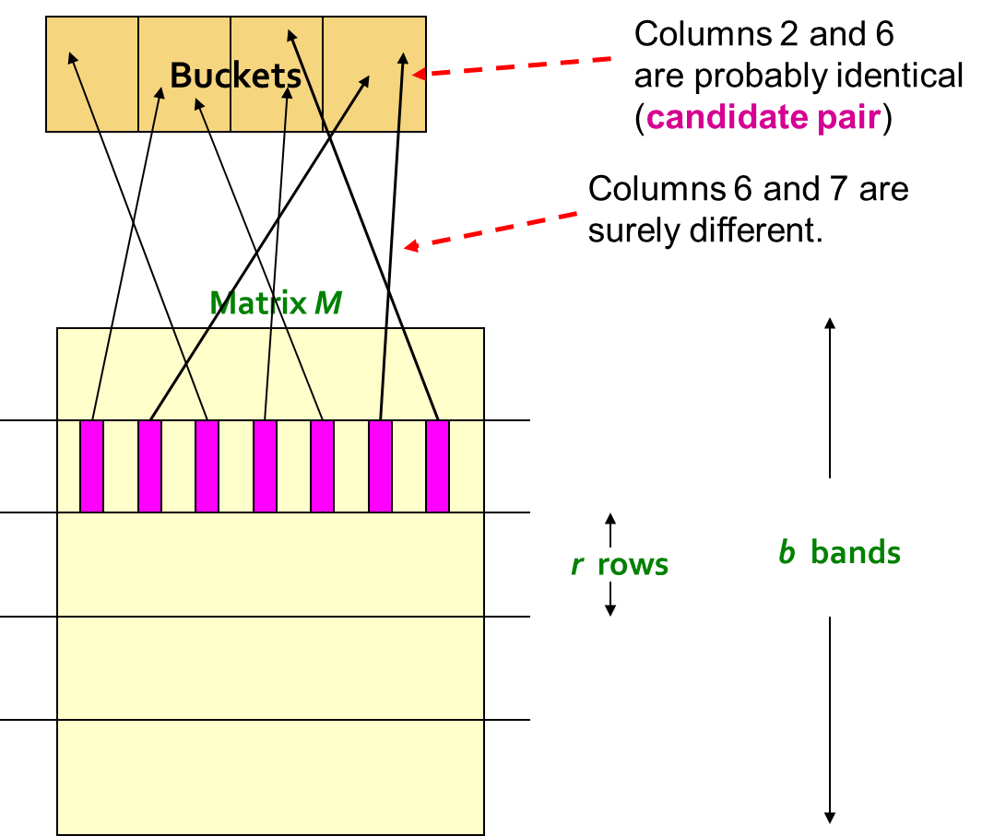
Locality-Sensitive Hashing (LSH)
Focus on pairs of signatures likely to be from similar documents

Slide 16
Locality-Sensitive Hashing (LSH)
Focus on pairs of signatures likely to be from similar documents
Step 3:
If the bands in the same horizontal direction of two documents are mapped to the same hash value, we will Map these two documents to the same hash bucket, which means that the two documents are similar enough.
Consequently, by adjusting the parameters, the more similar, the easier it is to be in a hash bucket; the less similar, the less likely it is to be in a hash bucket.
When the similarity is higher than a certain value, the probability will become very large and quickly approach 1, while when the similarity is lower than a certain value, the probability will become very small and quickly approach 0.

Slide 17
Locality-Sensitive Hashing (LSH)
Focus on pairs of signatures likely to be from similar documents
b bands, r rows:
s∈[0,1] is the similarity of the two columns (documents).
For any band of two documents (r rows), the probability that the two band values are the same is: s^{r}
In other words, the probability that the two bands are not the same is: 1-s^{r}
There are b bands in these two documents, and the probability that the b bands are all different is: (1-s^{r} )^{b}
At least one of these b bands has the same probability is 1-(1-s^{r})^{b}

Slide 18
Locality-Sensitive Hashing (LSH)
Focus on pairs of signatures likely to be from similar documents
In this way, the probability that two documents are mapped to the same hash bucket can actually be controlled by controlling the value of the parameter.
Say, b=20, r=5:
When s = 0.8:
Pr(LSH(O₁) = LSH(O₂))=1-(1-0.8⁵)⁵=0.9996439421094793
When s = 0.2:
Pr(LSH(O₁) = LSH(O₂))=1-(1-0.2⁵)⁵=0.0063805813047682

Slide 19
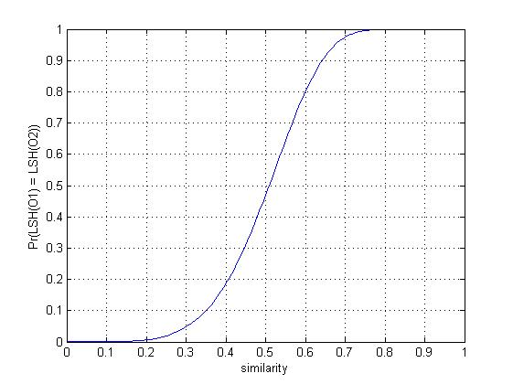
Locality-Sensitive Hashing (LSH)
Focus on pairs of signatures likely to be from similar documents

Slide 20
Example: Find Images With Similar Features

Slide 21

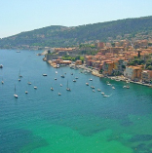
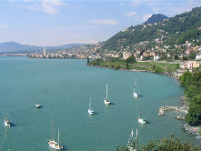

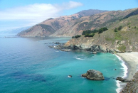
Example: Find Images With Similar Features
Introduction
Use the algorithm introduced previously to find images with the most similar features
For instance, find the nearest neighbors from a collection of 2 million images

Slide 22



Example: Find Images With Similar Features
Dataset: Fashion Product Images Dataset
Reference: https://www.kaggle.com/datasets/paramaggarwal/fashion-product-images-dataset
Description: large image dataset contains high resolution product images from e-commerce industry; a table indicate category of images
Image Resolution: 60 x 80
# of images: around 50000
In this project, we want to find all the similar images for a given picture
e.g. If the given picture is a shoe, we want to find all images that contain a shoe

Slide 23
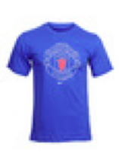
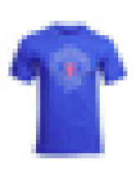
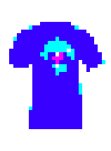
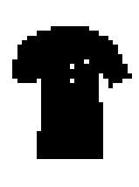
Example: Find Images With Similar Features
Preprocess images
Convert a image into a matrix
Image.open(path)
return an PIL.Image object
np.round(np.array(img.resize((30, 40))) / 255)
return array has shape (80, 60, 3) & round the value of pixels (e.g. [0.73, 0.23, 0.83] → [1, 0, 1])
convert_img(img)
convert colored pixels into black pixels
to_2D_matrix(img)
return array has shape(80, 60) (e.g. [1, 0, 1] → 0 & [0, 0, 0] → 1)

Slide 24
Example: Find Images With Similar Features
Shingling
Images that have lots of shingles in common have similar 5 by 5 pixels blocks, even if the blocks appears in different order
K = 5, 5 by 5 pixels block
Every time, move 1 pixel to obtain a new shingle
Image Resolution = 30 x 40, total shingles = 25 x 35 = 875
Shingles will be stored as a 5 x 5 numpy matrix first, and then it will be flatten into a numpy array containing 25 elements
Create Boolean Matrices
Min-Hashing
Locality-Sensitive Hashing

Slide 25
Example: Find Images With Similar Features
Parallel Computing in the Algorithm
Case 1: Find Images With Similar Features
Basic Idea
Each processor takes a portion of the images
First column represents the given image
Return a list of names of similar images for a given picture
Send the list to root node
Case 2: Group Images With Similar Features
Basic Idea
Each processor takes a portion of the images
Return a list of tuples (image name, shingles)
Send the list to root node
Root node run the algorithm (Min-Hashing, LSH) to group images

Slide 26
Implementation with mpi4py

Slide 27
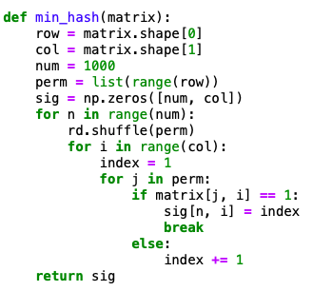
Min-Hashing

Slide 28
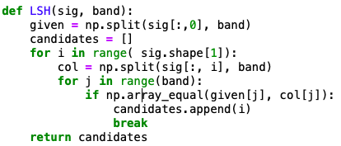
Locality-Sensitive Hashing

Slide 29
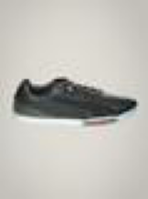






Example: Find Images With Similar Features
Given Image
Images With Similar Features
# of images found: 185
# of shoes images: 133
# of other images: 52
Accuracy: 133 / 185 = 72%

Slide 30


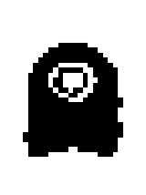

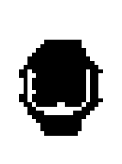
Example: Find Images With Similar Features
Deficiency
Using np.round() to eliminate the background in the image may also remove light colored pixels (e.g. white skin will be removed)
Some products contains white will be affected by the algorithm (e.g white shoes, white clothes)
Decrease the resolution of the image quality to raise computing speed
Two different products may have close patterns (e.g bag & bottle)
Algorithm may miss comparing some parts of images (permutations maybe not enough)
Improvement
Consider colors in the algorithm
Increase the resolution of images
Use better hashing method (e.g. perceptual hash, usually used in fingerprint recognition)

Slide 31
Another Application: Find ‘Near Duplicate’ Documents
Shingling
For example, K = 2; Document D1 = abcab
Set of 2-shingles: S(D1) = {ab, bc, ca}
Documents that have lots of shingles in common have similar text, even if the text appears in different order
Min-Hashing
Locality-Sensitive Hashing

Slide 32
Question?

Slide 33
Thank you!

